Slide 1
MPPC
(64ch)
MPPC
(64ch)
CIRASAME module
40V-70V
ASIC
(32ch)
ASIC
(32ch)
ASIC
(32ch)
ASIC
(32ch)
Probe
output
MAX
19232
Comparator
output
Analog high-gain
output
128
FPGA
DIP Switch
4
Analog
switch
SDRAM
GTX
AD9220
Logic
translate
Jitter
cleaner
Logic
translate
Power
supply
NIM
SFP1
SFP2
Coaxial
Coaxial
Coaxial
Coaxial
DC +20-35V

Slide 2
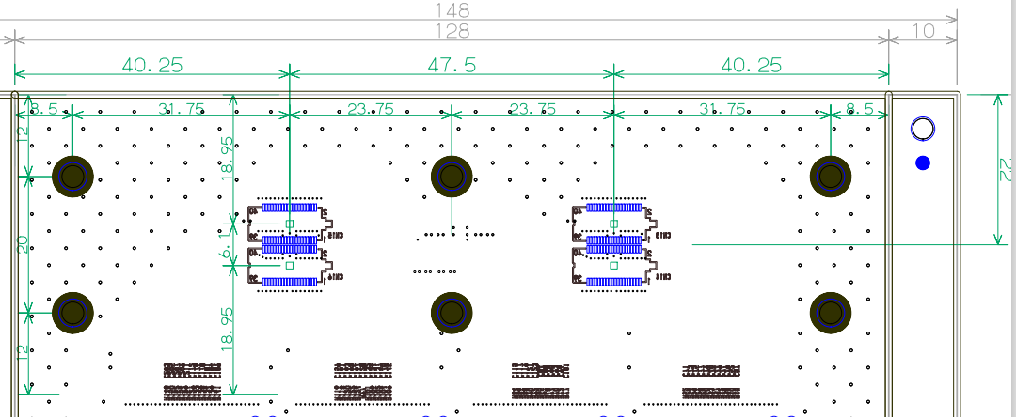
40.25
47.5
40.25
8.5
31.75
23.75
23.75
31.75
8.5
15
22
18.95
6.1
20
18.95
15

Slide 3
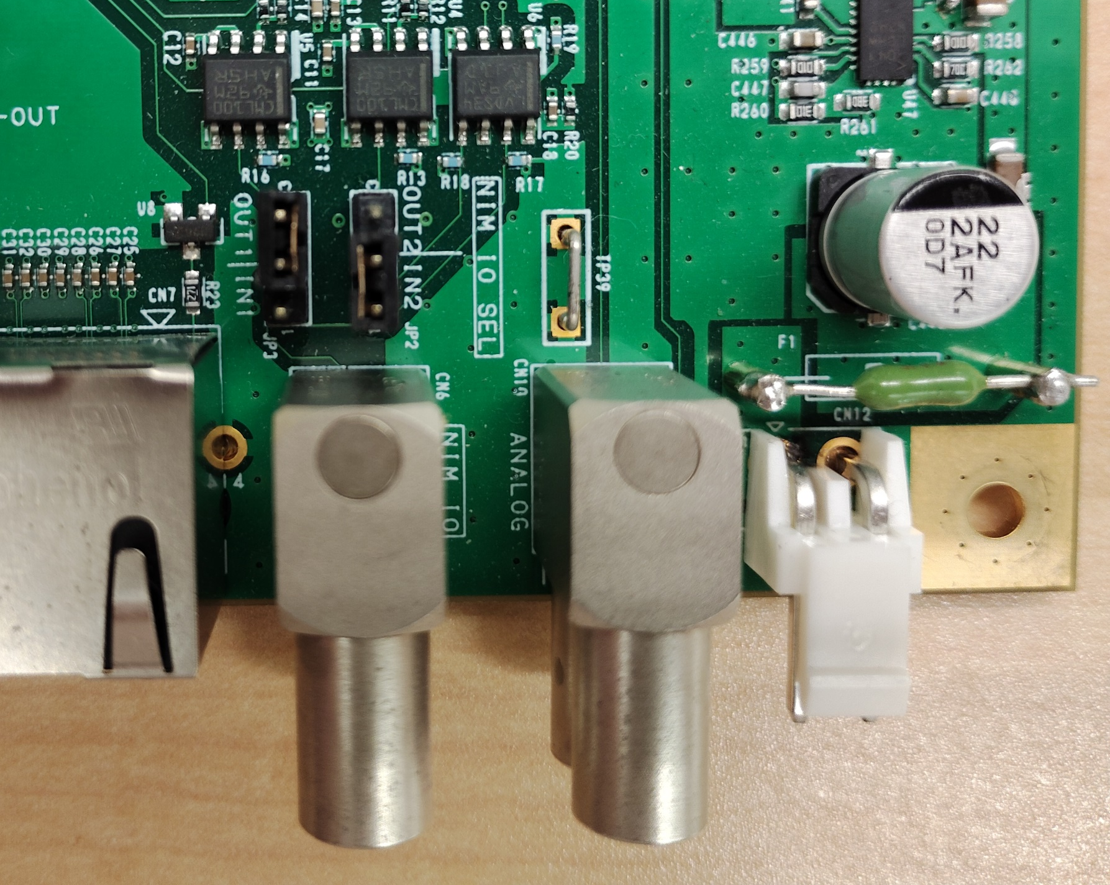
Analog/probe out
NIM IO

Slide 4
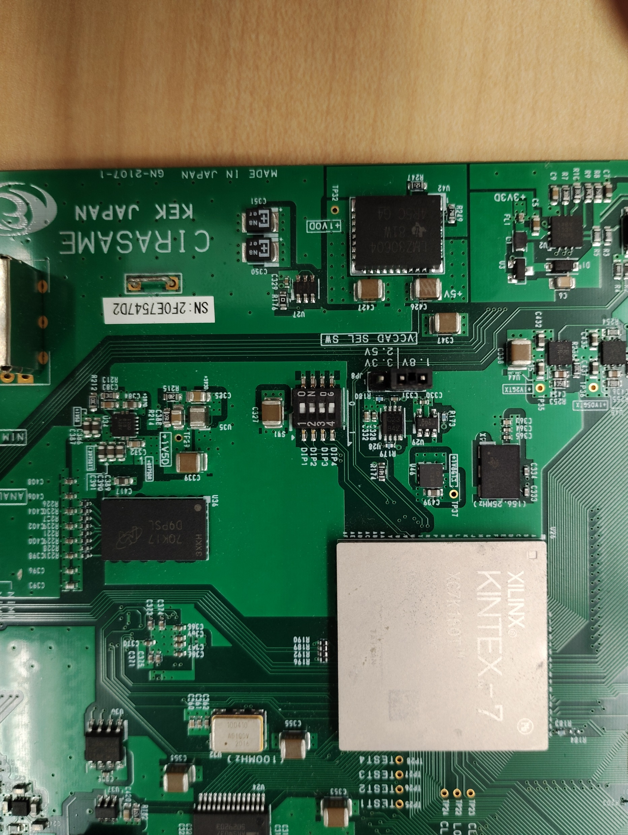

Slide 5
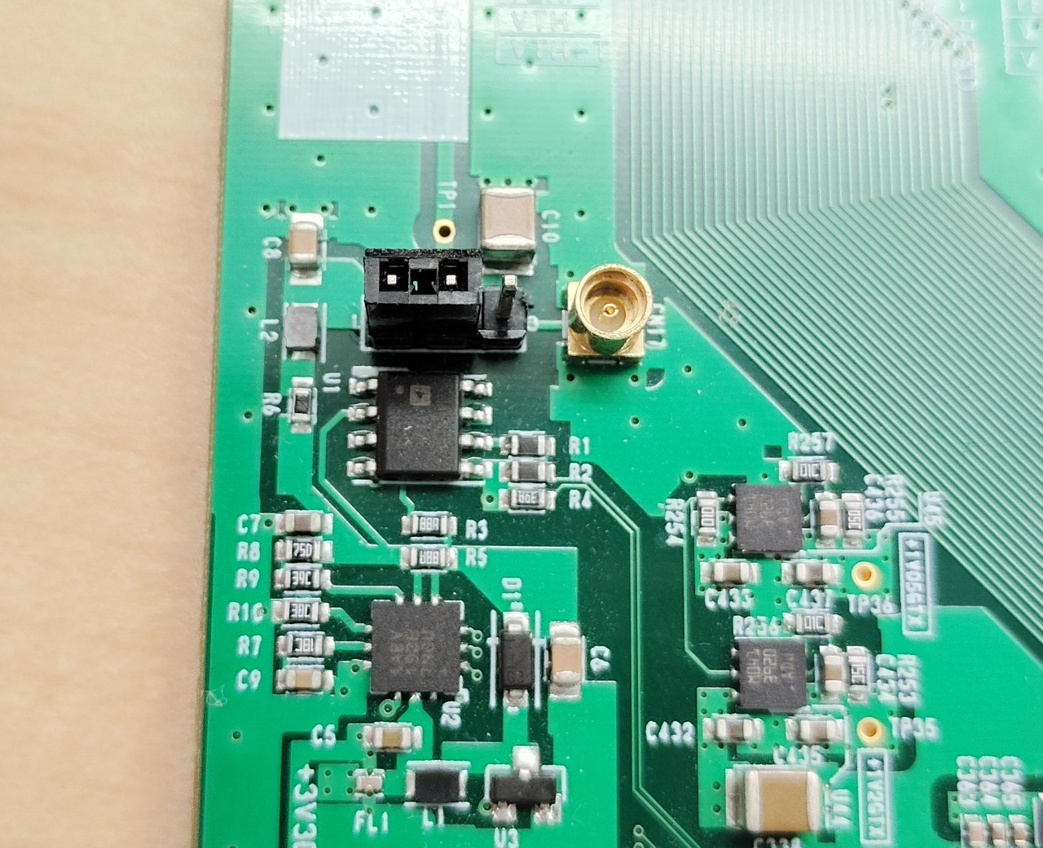
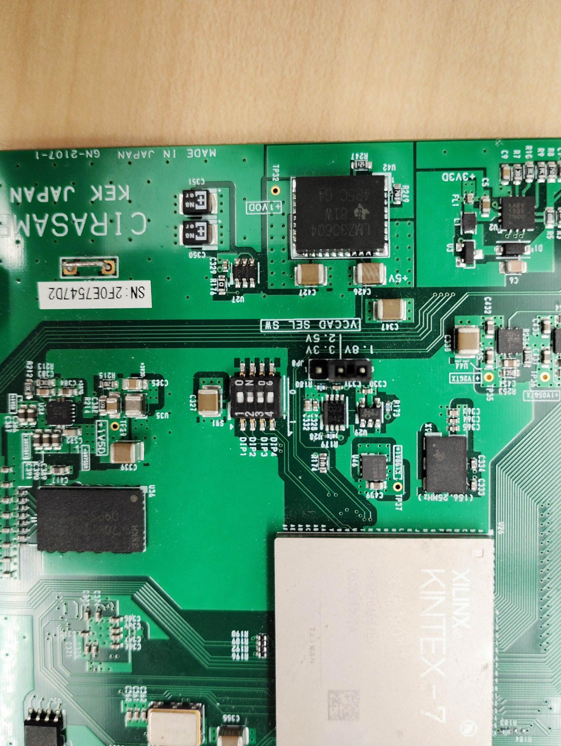
Bias selection
External bias

